Slide 1

The Impact of Technical Writing on Knowledge Management Systems and Business Performance – Case Study Analysis
[Elevate Services] - [July 2024]
Author: Priya Bhatia

Slide 2


Abstract
Organizations regard knowledge as a vital asset, on par with technological resources. Technological and business writing practices have evolved as technology advances and business regulations change.
This case study examines the influence of technical writing on knowledge management systems and its subsequent effect on business performance.

Slide 3
Keywords
Technical Writing, TW, Knowledge Management Systems, KMS, Knowledge base, KB, Business Performance, Case Deflection, Customer Satisfaction, CSAT, Product Usage, Regulatory Adherence, Legal Liabilities, Machine Learning, AI, User Enablement, Developer Workload, Subject Matter Expert, SME
Terminology

Slide 4
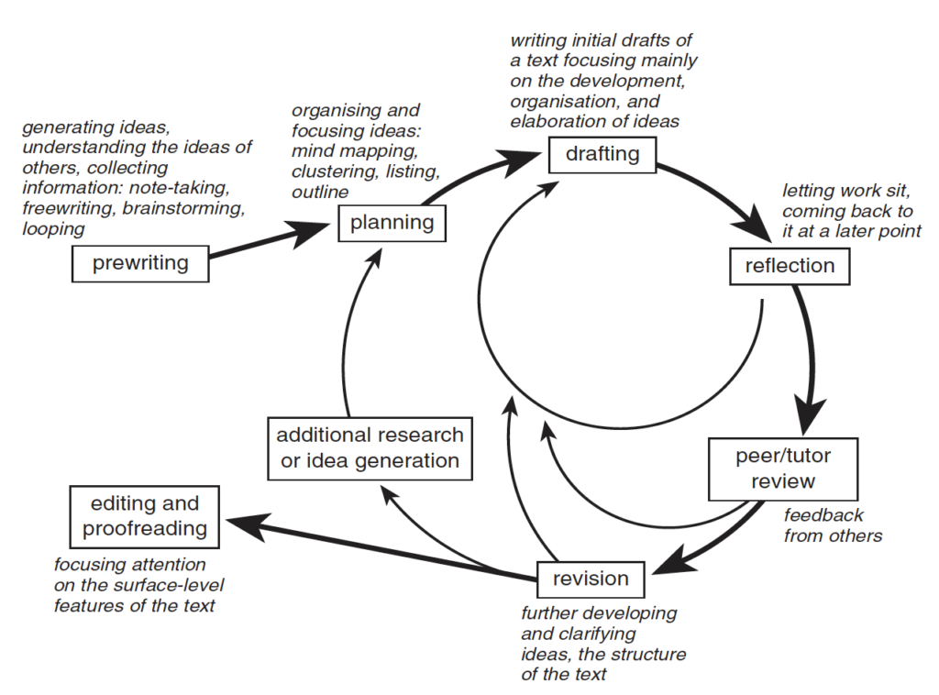
Introduction
Technical Writing has emerged as a crucial instrument for communication. It simplifies complex information, making it easy to understand. This case study delves into:
The significance of technical writing in business and its various advantages.
How technical writing aids in efficient knowledge management and boosts business performance.

Slide 5
Introduction
Elevate’s 2023 CSAT Results: Emphasize the role of technical writing in boosting customer satisfaction.
Customer Feedback: Indicates that clear and comprehensive documentation has led to higher customer satisfaction ratings.
Future Exploration: Investigate the impact of technical writing on efficient knowledge management and business performance

Slide 6




Gilbert + Tobin (G+T) – Our Esteemed Client
Identity
Gilbert + Tobin (G+T) is a renowned Australian legal firm established in 1988.
Services
They provide comprehensive legal services to diverse corporate and government clients, both in Australia and internationally.
Presence
With a strong presence in Sydney, Melbourne, and Perth, and a focus on the Asia-Pacific

Slide 7


Gilbert + Tobin (G+T) – Our Esteemed Client
region, G+T has made a significant impact on the legal landscape.
Culture
Their unique flat hierarchy sets them apart from traditional law firms.
Milestones
A notable achievement is their advisory role in the largest public M&A deal in Australia’s history, the A$39 billion acquisition of Afterpay Limited by Square.

Slide 8
1. Gilbert + Tobin (G+T) on Technical Writing
G+T’s service satisfaction ratings for Technical Writing: - Quality of Work: 9/10 - Peace of Mind: 10/10 - Value: 9.5/10
- Innovation: 8.5/10 - Proactive Partnership: 8/10
Feedback Highlights: - The G+T team appreciates enhancing peace of mind through more frequent updates and communication by the Technical Writing team. - High satisfaction with the quality of work and the value provided by the team. - They suggest more stakeholder interaction and innovative approaches.

Slide 9

Problem Statement
Reliance on KMS: Organizations heavily depend on Knowledge Management Systems (KMS) as a crucial tool for knowledge creation, sharing, and application.
Challenges with Technical Information: The effectiveness of KMS is often compromised due to the complexity of technical information, posing significant challenges for users.
Need for Clear Documentation: There is a pressing need for precise, concise, and understandable documentation to make complex technical information more accessible.

Slide 10
Problem Statement
Impact on KMS Use and Performance: The abundance of complex technical information can create a barrier for non-technical personnel, adversely affecting the use of KMS and overall organizational performance.

Slide 11

1. Cost Implications of Inadequate Documentation
Financial repercussions for companies based on studies:
Aspect | Implications
Customer Retention | Poor documentation led to dissatisfaction and business loss.
Employee Efficiency | Inefficient internal documentation wasted time and effort.
Regulatory Adherence | Non-compliance led to hefty fines.
Legal Liabilities | Insufficient documentation led to liability lawsuits.

Slide 12

2. Challenges and Opportunities
The 2023 CSAT Feedback: Highlights key improvement areas including enhanced customer service and better functionality.
Addressing Challenges: Tackled by implementing robust technical writing practices, thereby improving customer experience and operational efficiency.
Impact on KMS: Affected by advancements in technology and new regulations.

Slide 13
2. Challenges and Opportunities
Drawbacks of Transformations: These transformations may diminish the distinct features of technical and business writing.
Role of AI and Machine Learning: Enables faster processing and understanding for large data volumes with limitations.
Limitations of AI: May struggle with understanding the subtleties of human language.

Slide 14

Proposed Solution
Technical writing addressed several critical issues in Elevate business including:
Case Deflection: Reduced the number of support tickets by providing users with accessible and relevant information, allowing the support team to focus on more critical tasks.
Customer Satisfaction: Informative technical documentation enhanced the customer experience, demonstrating the company's commitment to their needs. The 2023 CSAT results indicated a positive response to the quality of documentation provided, with a notable increase in customer satisfaction ratings.

Slide 15
Proposed Solution
Product Adoption: Technical documentation, available 24/7 and potentially including videos, URLs, or interactive elements, allowed users to access relevant information conveniently.

Slide 16

1. Technical Writing: The Role
A key in addressing challenges by translating complex information into user-friendly content.
Bridges the gap between technical and non-technical personnel, enabling effective use of KMS and enhancing organizational performance.
Involves creating various documentation like guides and leaflets that instruct users on product usage.

Slide 17

2. Technical Writing: The Nature
Communicates complex information in easily understandable, relatable, and reusable content.
Focuses on user understanding rather than emotional engagement unlike creative writing.

Slide 18
3. Technical Writing in Knowledge Management
Contribution | Description
Content Creation | Generate documentation, user guides, FAQs, and troubleshooting articles.
Content Organization and Categorization | Structure and organize information effectively within the KMS, facilitating easy navigation and retrieval.
Standardization and Consistency | Ensure the content within the KMS adheres to consistent writing styles, terminology, and formatting.
Content Updates and Maintenance | Review and update existing content to reflect product changes, processes, or industry standards.

Slide 19
3. Technical Writing in Knowledge Management
Contribution | Description
User-Friendly Documentation | Produce intuitive guides that cater to the requirements and tastes of the system’s end-users.
Searchability and Metadata | Comprehend the significance of metadata and keywords for efficient discoverability within the KMS.
Collaboration with SMEs | Work closely with Subject Matter Experts (SMEs) to gather information and ensure the accuracy and completeness of the content.
Training and Support Documentation | Create training materials, user guides, and support documentation within the KMS.

Slide 20
3. Technical Writing in Knowledge Management
Elevate Periodic Customer Feedback affirmed
TW role as pivotal
TW enhances the usability, accessibility, and value of the Knowledge Management System (KMS)
create, organize, update, and maintain content for effective knowledge distribution
expertise in crafting clear, user-focused guides is indispensable for KMS users.

Slide 21

Impact of Knowledge Management on Organizational Performance
Quick dissemination of information across departments.
Improved efficiency and cost-effectiveness.
Reduced time searching for information increases productivity.

Slide 22
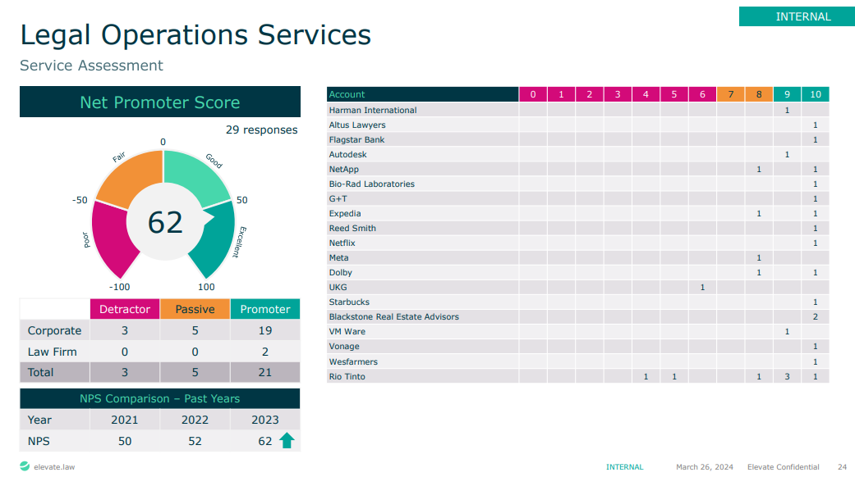
1. Elevate Customer Success: TW Impact
Technical Writing: Enhanced customer satisfaction and product adoption and mitigated potential financial and legal risks.
Simplification: Simplified complex information and empowered users contribute significantly to a company’s success.
2023 Annual CSAT Results: The results for the Legal Operations Services at Elevate demonstrate this impact, particularly for customers like G+T.

Slide 23
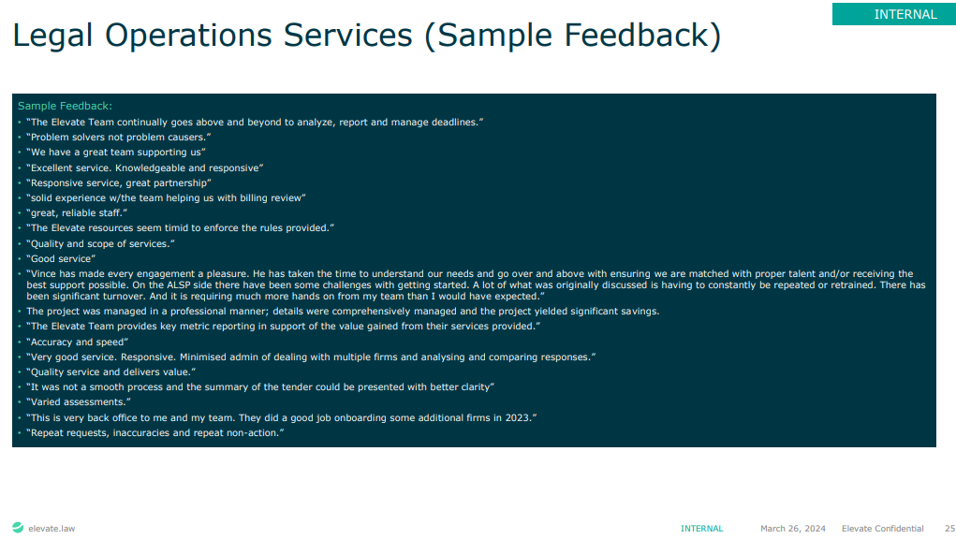
1. Customer Success: The Impact
Customer Feedback:
"The Elevate Team continually goes above and beyond to analyze, report, and manage deadlines"
"We have a great team supporting us."

Slide 24
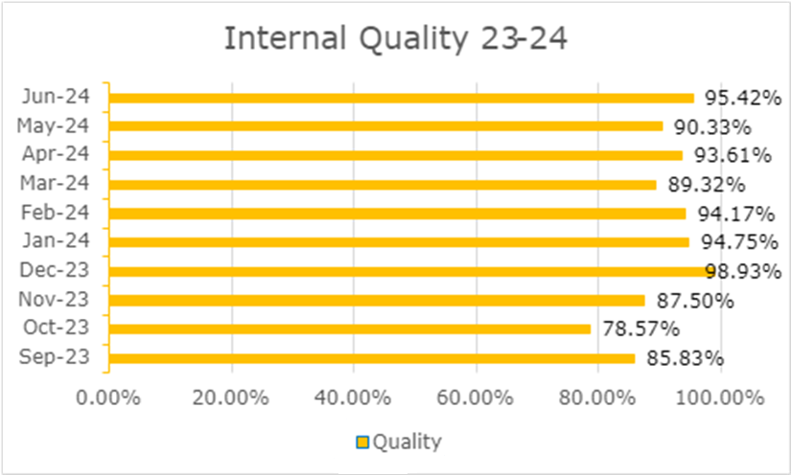
2. Simplified Complexity
Sped up understanding of complex products.
Provided users with necessary information upfront.
Enhanced even the internal quality of Knowledge Bases (KBs) to a higher level, guided by pre-established audit metrics about the simplicity of a KB, user comprehension, and its searchability across the Knowledge Management System (KMS).

Slide 25
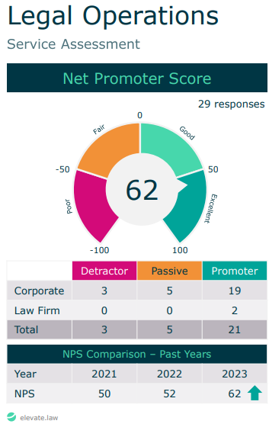
3. Elevate Success
CSAT Results:
Highlight the effectiveness of technical writing within Legal Operations Services.
The NPS for Legal Operations Services improved significantly from 50 in 2021 to 62 in 2023
The improvement is also attributed to the high-quality documentation and support provided by the technical writing team.

Slide 26
3. Elevate Success
Our Professionally designed documentation enhanced company’s financial health by:
Empowering Users and Potential Customers: Provides comprehensive information for informed decision-making, enabling users to excel with the product.
Reducing Developer Workload: Handling documentation tasks alleviates developers’ workloads, facilitating timely project delivery.

Slide 27
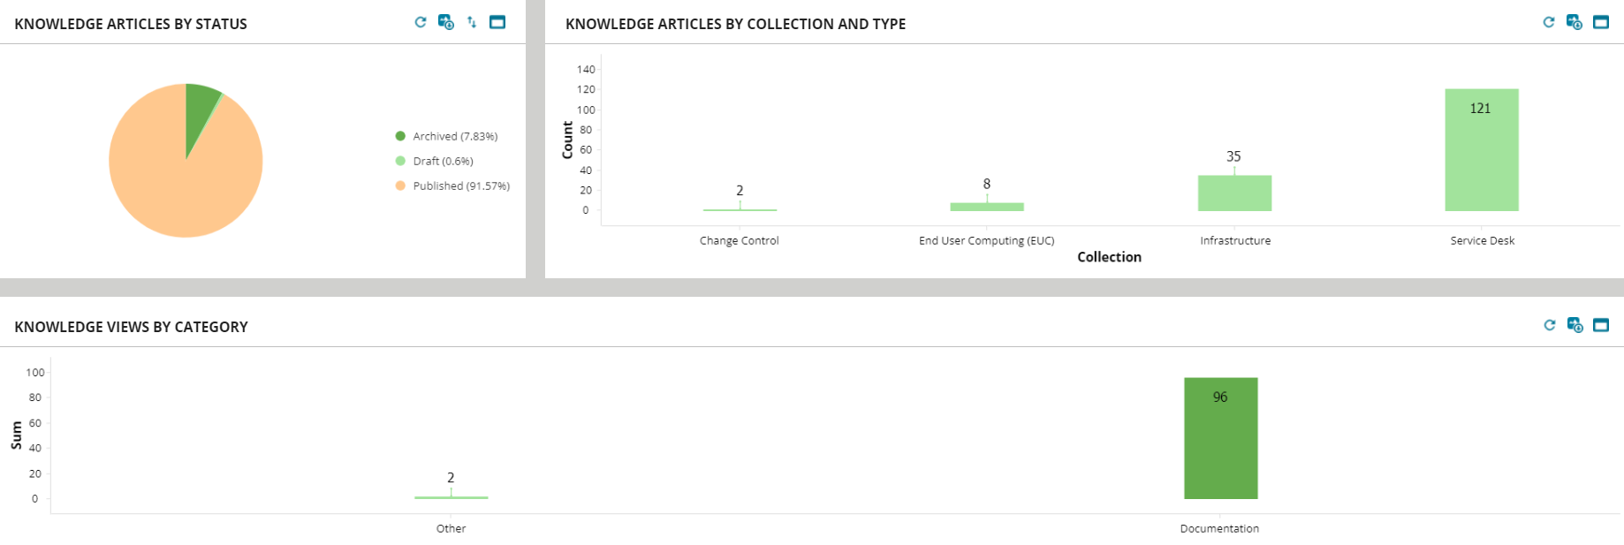
Knowledge Overview Dashboard - Customer

Slide 28
Results
Result Area | Details
Increased Organizational Efficiency | KBs implementation defined KM goals, boosting both organizational and team efficiency.
Improved Taxonomy and Discoverability | Advanced keyword analysis and optimization for KM content in the KBs resulted in an increase in organic traffic.
Enhanced Training Effectiveness | 200 KB-based training materials improved effectiveness.
Boosted Team Efficiency | The co-management of a 200-article knowledge base for multiple teams resulted in an enhancement in team efficiency

Slide 29
Results
Result Area | Details
Quality Improvement | Evident from an increase in quality following quarterly audits. Specifically, over July 23-24 with internal and customer quality at 92% and near 100%, respectively.
Customer Satisfaction | The Customer Satisfaction results from 2023 highlighted an overall satisfaction score of around 90% for the technical writing services provided. The team received specific praise for their professionalism, responsiveness, and technical competence.

Slide 30
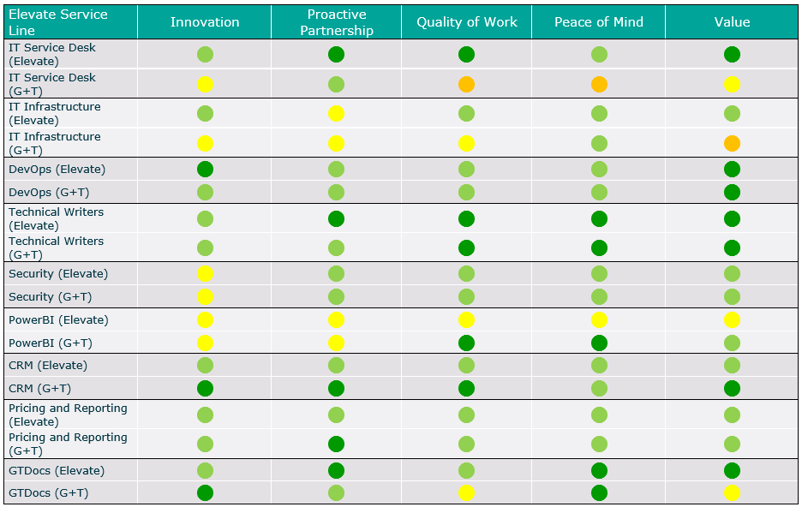
Performance Evaluation for Technical Writing Against Key Business Attributes
Key Strengths:
Proactive Partnership: Successful collaboration with stakeholders.
Quality of Work: High-quality output consistently delivered.
Value: Significant contributions to the organization.
Innovation: Innovation by the team at G+T meets Elevate’s expectations
Noteworthy Achievement:
Peace of Mind: The team’s ability to instill confidence and alleviate stakeholder stress.

Slide 31




Conclusion
Technological Advancements
Future Outlook
Adapting practices guided by tech evolution and privacy insights.
The role of technical writing in enhancing knowledge management systems has become more critical than ever due to rapid technological advancements.
CSAT Results
Tech Writing
Benefits
Simplifies complex information.
Empowers users.
Directly contributes to business performance.
High satisfaction scores and commendations for the team’s professionalism and competence.
These results serve as a testament to the effectiveness of our technical documentation.
Excellence in technical writing and knowledge management for superior user experience

Slide 32
References
Rani S. & Sania K. (2016). Case Study: Impact of Knowledge Management on Organizational Performance. Advances in Management, 9(5), 9-13.
Uddin D. M. M. & Sultana F. (2022). Employee Perception on the Impact of Knowledge Management on Organizational Performance.

